Slide 1

Database Recovery System
Name: Shanmugavel R
Register No: 23CS110

Slide 2


Database Recovery Systems: Ensuring Data Integrity
A robust recovery system is critical for database management. It prevents data loss and ensures consistency after failures. This system supports transaction processing and maintains ACID properties vital for reliable operations.
by Vimal

Slide 3

Understanding Database Failures
Transaction Failures
Logical errors and system mishaps interrupt operations.
System Crashes
Hardware or OS errors cause abrupt halts.
Media Failures
Disk failures and data corruption compromise storage.
Examples
Power outages during writes, disk head crashes.

Slide 4
Key Concepts in Recovery
Transaction Logs
Checkpoints
Write-Ahead Logging (WAL)
Shadow Paging
Capture all transaction activities for recovery.
Consistent database state snapshots at specific times.
Maintain shadow copies of pages during transactions.
Log updates prior to database changes for safety.
Examples include MySQL's binary log and PostgreSQL WAL implementations.

Slide 5
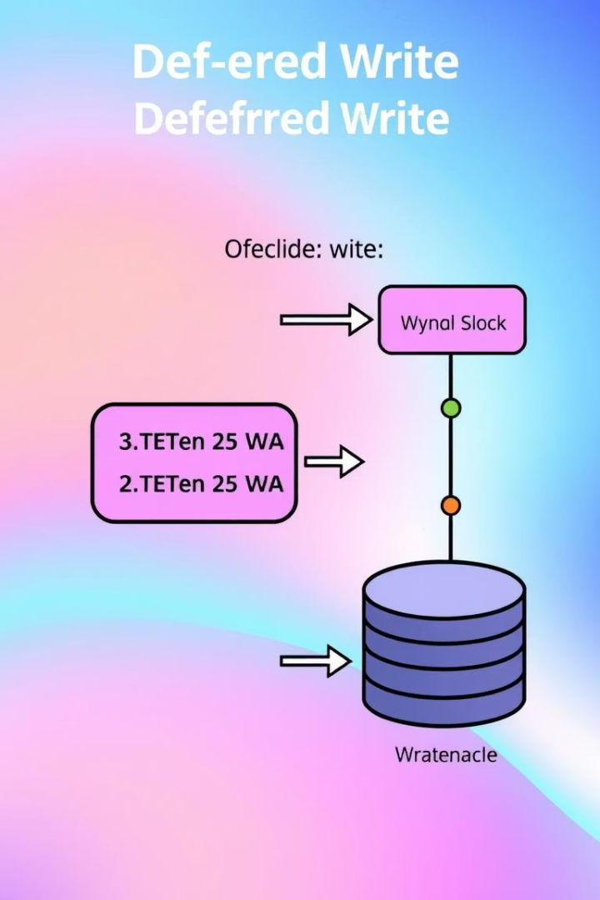
Recovery Techniques: Deferred Update
Delayed Database Writes
Simplicity
Easier to implement but may require redo operations.
Updates only applied when transactions commit.
Efficiency
Reduces writes during transaction execution.
Oracle sometimes uses deferred writes to optimize performance.

Slide 6

Recovery Techniques: Immediate Update
Instant Data Writing
Complex Recovery
Faster Recovery
Database updates happen immediately with transactions.
Requires redo and undo operations for consistency.
Reduces recovery time by maintaining fresh data states.
SQL Server employs immediate update as a standard practice.

Slide 7



Checkpointing Techniques
Incremental Checkpoint
2
Saves only recent changes since the last checkpoint.
Full Checkpoint
Writes all dirty buffers to stable storage.
1
Fuzzy Checkpoint
3
Allows ongoing transactions during checkpointing.
DB2 uses fuzzy checkpointing to minimize downtime.

Slide 8

ARIES Recovery Algorithm
What is ARIES?
Core Components
Recovery and Isolation Exploiting Semantics algorithm.
Combines WAL, checkpointing, and transaction management.
Usage
Capabilities
Implemented in IBM DB2 and other advanced systems.
Supports fine-grained locking and page-level recovery.

Slide 9

Conclusion: Importance of Robust Recovery
Ongoing Innovation
Maintaining Trust
Advances improve efficiency and reliability continuously.
Reduced Downtime
Reliable recovery builds user and customer confidence.
Data Durability
Minimizes system outage, enhancing business continuity.
Recovery ensures that data is not lost after failures.

